Slide 1

Introduction to algorithms binary search trees
Lecture 8
Tuesday, 18 November 2021

Slide 2
Coursework project!!
Your coursework project will be released this evening!
Read instructions CAREFULLY!
You have TWO WEEKS to submit
Answers MUST BE TYPED
Upload ONE PDF FILE onto submission box (Moodle)
NO HELP FROM TEACHERS!!
PLAGIARISM & CHEATING WILL BE TAKEN SERIOUSLY!!

Slide 3
Binary trees & unsorted lists
searching:
O(n)
17
BINARY SEARCH
12 | 4 | 6 | 17 | 8 | 19 | 2
4
19
searching through BTs is O(treeSize)=O(n)
12
6
8
2
searching:
O(log(n))
2 | 4 | 6 | 8 | 12 | 17 | 19

Slide 4
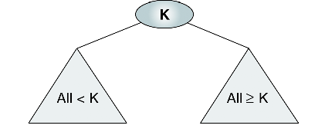
A special class of bts: Binary search trees
less than 8
bigger than 8
2 | 4 | 6 | 8 | 12 | 17 | 19
all values in left < the root value
all values in right > the root value

Slide 5
A special class of bts: Binary search trees
20
5
30
4
7
25
40
1
6
45

Slide 6
A special class of bts: Binary search trees
20
5
30
4
7
25
40
1
4.1
27
45

Slide 7
A special class of bts: Binary search trees
20
5
30
4
7
25
40
1
4.1
35
45
?

Slide 8
A special class of bts: Binary search trees
20
5
30
4
7
25
40
1
4.1
35
45
3
44

Slide 9
A special class of bts: Binary search trees
20
5
30
4
7
25
40
1
4.1
35
45
4.05
44

Slide 10
Finding min/max in: Binary search trees

Slide 11


Finding min/max in: Binary search trees
20
5
30
$$h$$
$$O(h)$$
4
7
25
40
1
4.1
35
45
smallest node is always in the left subtree
44
largest node is always in the right subtree

Slide 12
BST traversal
By traversing a BST
we visit all the nodes
in a certain order
and create a
list of node values
A
B
C
D
E
[A,B,C,D,E]
[D,B,A,C,E]
[B,D,C,E,A]

Slide 13
BST traversal schemes
By traversing a BST
we visit all the nodes
in a certain order
and create a
list of node values
Two main traversal schemes:
Breadth first
Depth first

Slide 14
Traversing a BST: breadth first
Each level is completely processed before the next level is started.
It visits all nodes with level depth 0, 1, 2 and so on ….
In each level we list the nodes from left to right.
EASIEST TRAVERSAL SCHEME
Level 0
A
A
A
Level 1
B E
B
E
B
E
Level 2
C D F
C
D
F
C
D
F
[ABECDF]

Slide 15
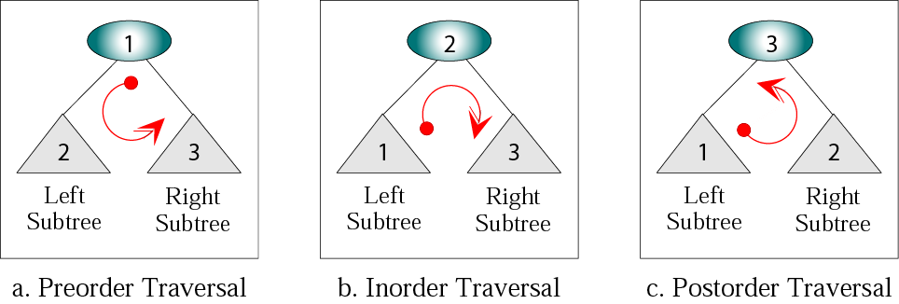
Traversing a bst: depth first(3 schemes)
THESE SCHEMES ARE PERFORMED RECURSIVELY!
N-L-R
L-N-R
L-R-N

Slide 16
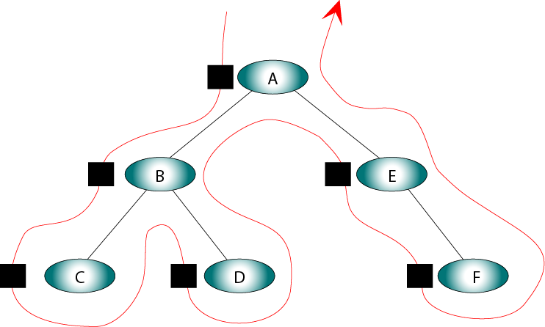
Preorder traversal: NODE-left-right (Nlr)
Visit root→Traverse left subtree→Traverse right subtree
1. node
2. left
A
3. right
B
E
C
D
F
A
B
C
D
E
F

Slide 17
Nlr example
H
D
L
B
F
J
N
A
C
E
G
I
K
M
O
H
D
B
A
C
F
E
G

Slide 18
Nlr example
H
D
L
B
F
J
N
A
C
E
G
I
K
M
O
H
D
B
A
C
F
E
G
L
J
I
K
N
M
O

Slide 19
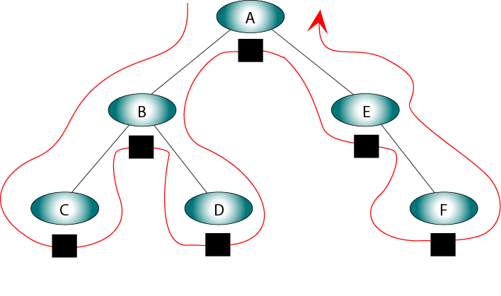
Inorder traversal: left-node-right (LNR)
Traverse left subtree→Visit root→Traverse right subtree
2. node
A
1. left
3. right
B
E
C
D
F
C
B
D
A
E
F

Slide 20
lnr example
H
D
L
RETURNS A SORTED LIST!!
B
F
J
N
A
C
E
G
I
K
M
O
A
B
C
D
E
F
G
H
I
J
K
L
M
N
O

Slide 21
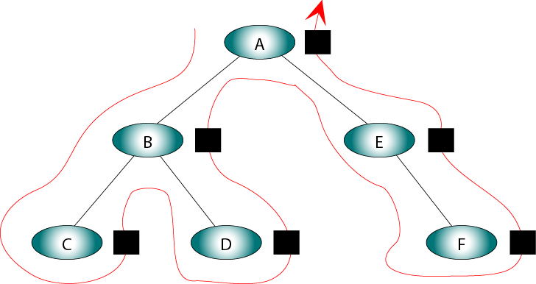
Postorder traversal: left-right-node (LRN)
Traverse left subtree→Traverse right subtree→Visit root
3. node
1. left
A
2. right
B
E
C
D
F
C
D
B
F
E
A

Slide 22
lrN example – (EXERCISE!)
H
D
L
B
F
J
N
A
C
E
G
I
K
M
O

Slide 23
Examples on a bst
7
NLR:
[7,4,2,6,9,8,12]
4
9
LRN:
[2,6,4,8,12,9,7]
2
6
8
12
LNR:
[2,4,6,7,8,9,12]
Observation: LNR returns a sorted list from a BST!!

Slide 24
building a BST from a sorted list
BALANCED MINIMAL BST
[0,1,2,4,6,7,8,9,10,11,13]
ROOT
7
2
10
1
4
9
11
0
6
8
13

Slide 25
UNSORTED LIST TO BST?!?
What if
the list
wasn’t sorted??
sort the list first!

